Slide 1
Human Computer Interaction
Final Year Project Presentation
Cem ULKER

Slide 2
Project Specification
Aim of the project is to compare Material Design, released by Google in 2014 and Flat Design, which gained popularity back in the 1970s.
Providing relevant background theory on Human Communication Interaction (HCI) for understanding how humans perceive their environments.
The objective would be to create two car infotainment systems in the same concept but with the following Material and Flat Design guidelines.

Slide 3
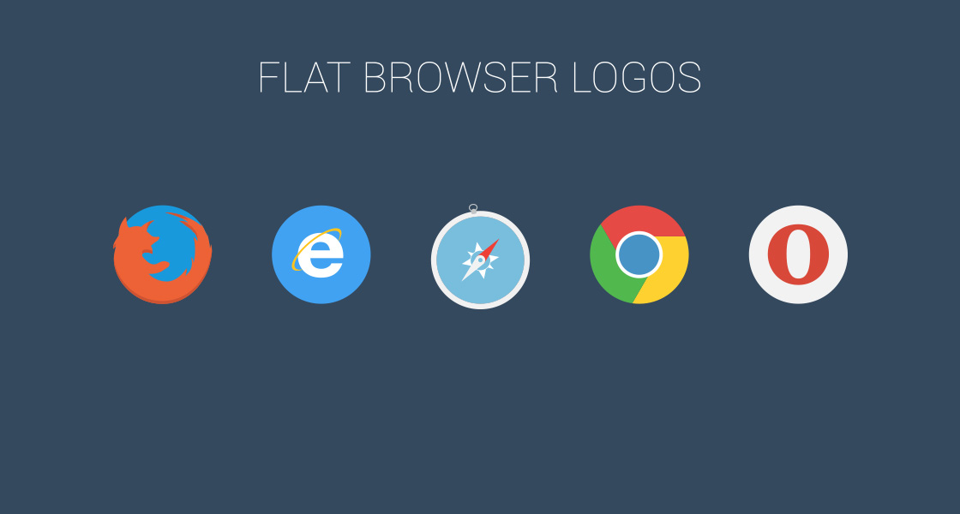
Flat Design

Slide 4
What is Flat Design?
User interface design concept that is based on minimalistic design
It usually uses 2D objects with vivid colours
The design concept was primarily developed to achieve easier understanding of the context and enhancing the user experience.
Benefits
Drawbacks
By using minimalistic shapes, texts and structure (ex. No shadows) the loading times are faster and smoother.
Using crisp, bright, shiny and clean UI elements makes flat design appealing rather than boring.
Users had many problems with understanding the context
Lack of shadows, three dimensional objects and effects takes away the cues that indicates to a user that how to interact with the interface
Priority of the buttons were not clearly identified and creates confusion on the user

Slide 5
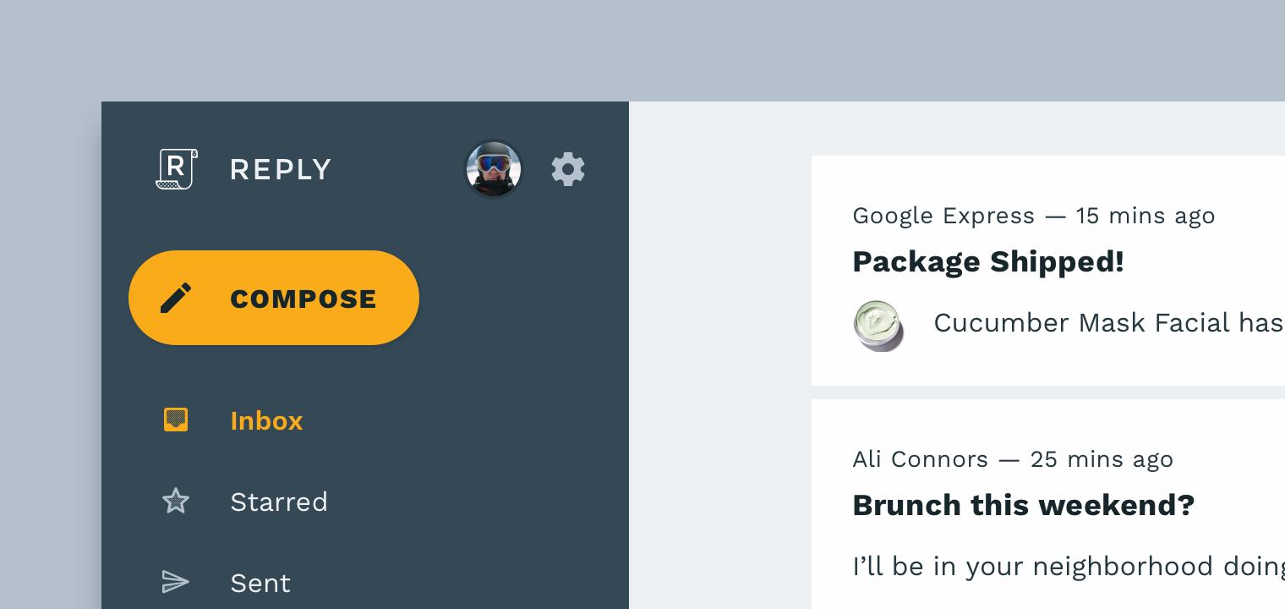
Material Design

Slide 6
What is Material Design?
Designed and released by Google in 2014 to be used firstly in Google internal applications.
After a while, Google allowed 3rd party users to implement the same design language by releasing guidelines to public.
Based on Flat Design
It focuses on every individual item to set their level of priority.
Benefits
Drawbacks
Unlikely as flat design, this interface uses real world objects to match and create seamless experience for the users.
Context is easily understandable
It was focusing on functionality over design
Google was forcing developers to choose themes from a small number of colour palette and small range of button and icon layout.
Designers did not like the strict guidelines

Slide 7
Why I choose this project ?
- Users don’t know what they need and interact with
- Manipulating these minds would be much easier with visual aspects.
- I can drag users attention wherever I want
- The most important human perception is visual so it is the best way to manipulate
Brief overview of HCI and design languages

Slide 8
Why Flat and Material Design?
-Most popular design languages in this decade
- Providing wide range of use without designing the tools for the software
- Guidelines making it better
- Universal design language
- Can be customisable for every need and sue
nufacturers

Slide 9
Why I did a car infotainment system ?
- Car industry is changing from top to toe
- Most of the corporations are hiring many UI, UX designers to make their systems more efficient and user friendly
- There are many potentials on the industry because it is in baby steps now
- Autonomous systems will be worldwide and this can be a good step
- Luxurious terms in the car industry is turning to software side instead of materials used in the interior

Slide 10
What my system provide?
- Tech systems are more appealing then traditional buttons
- It can be customisable however a car manufacturer needs
- Main focus is to produce 3rd party affordable infotainment solutions
- Making a standard over car manufacturers

Slide 11
Storyboards

Slide 12
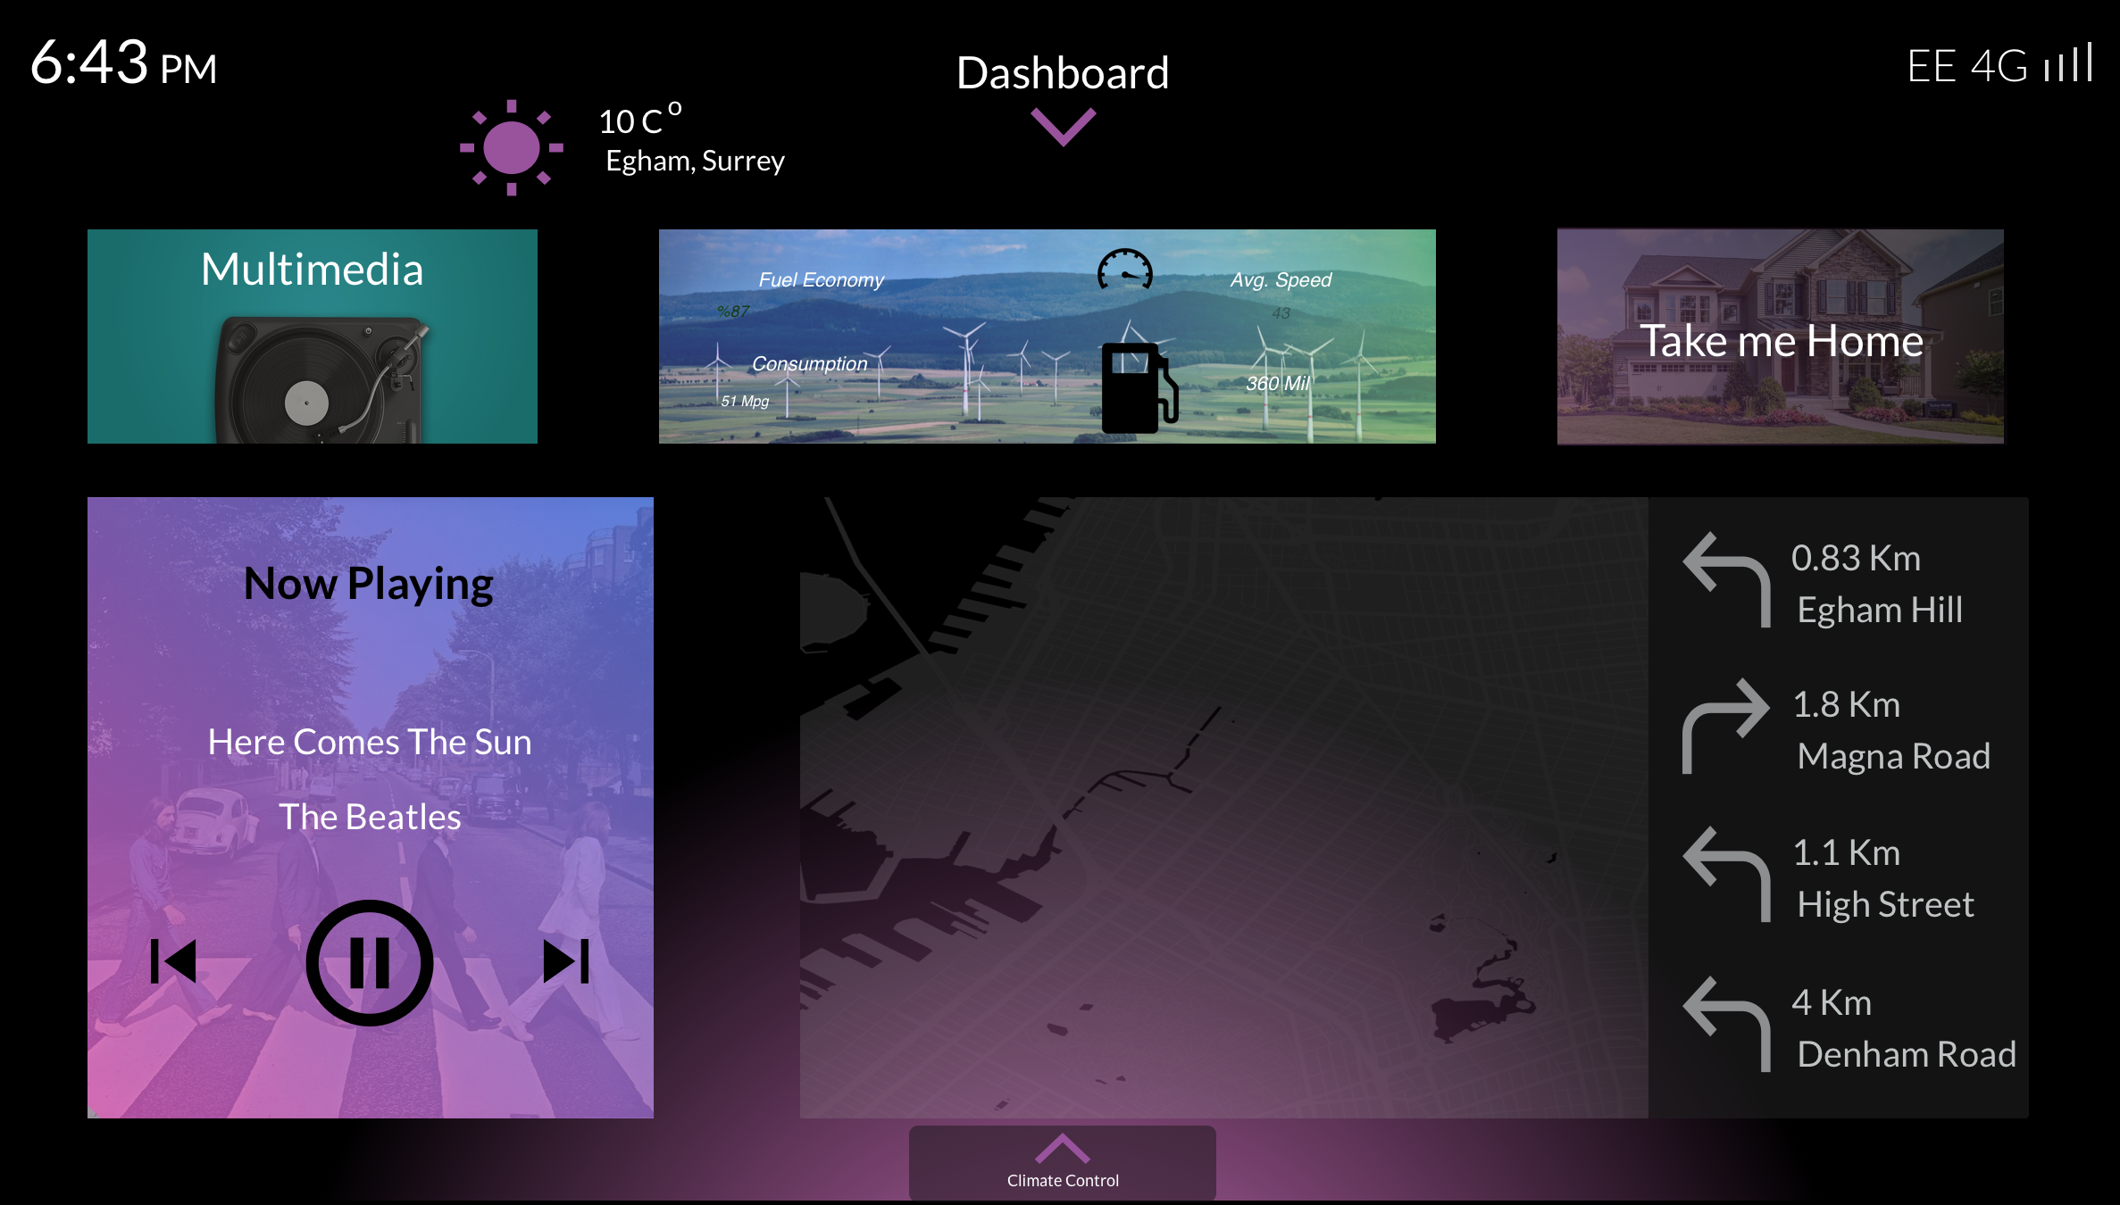
Main “Home” Screen

Slide 13
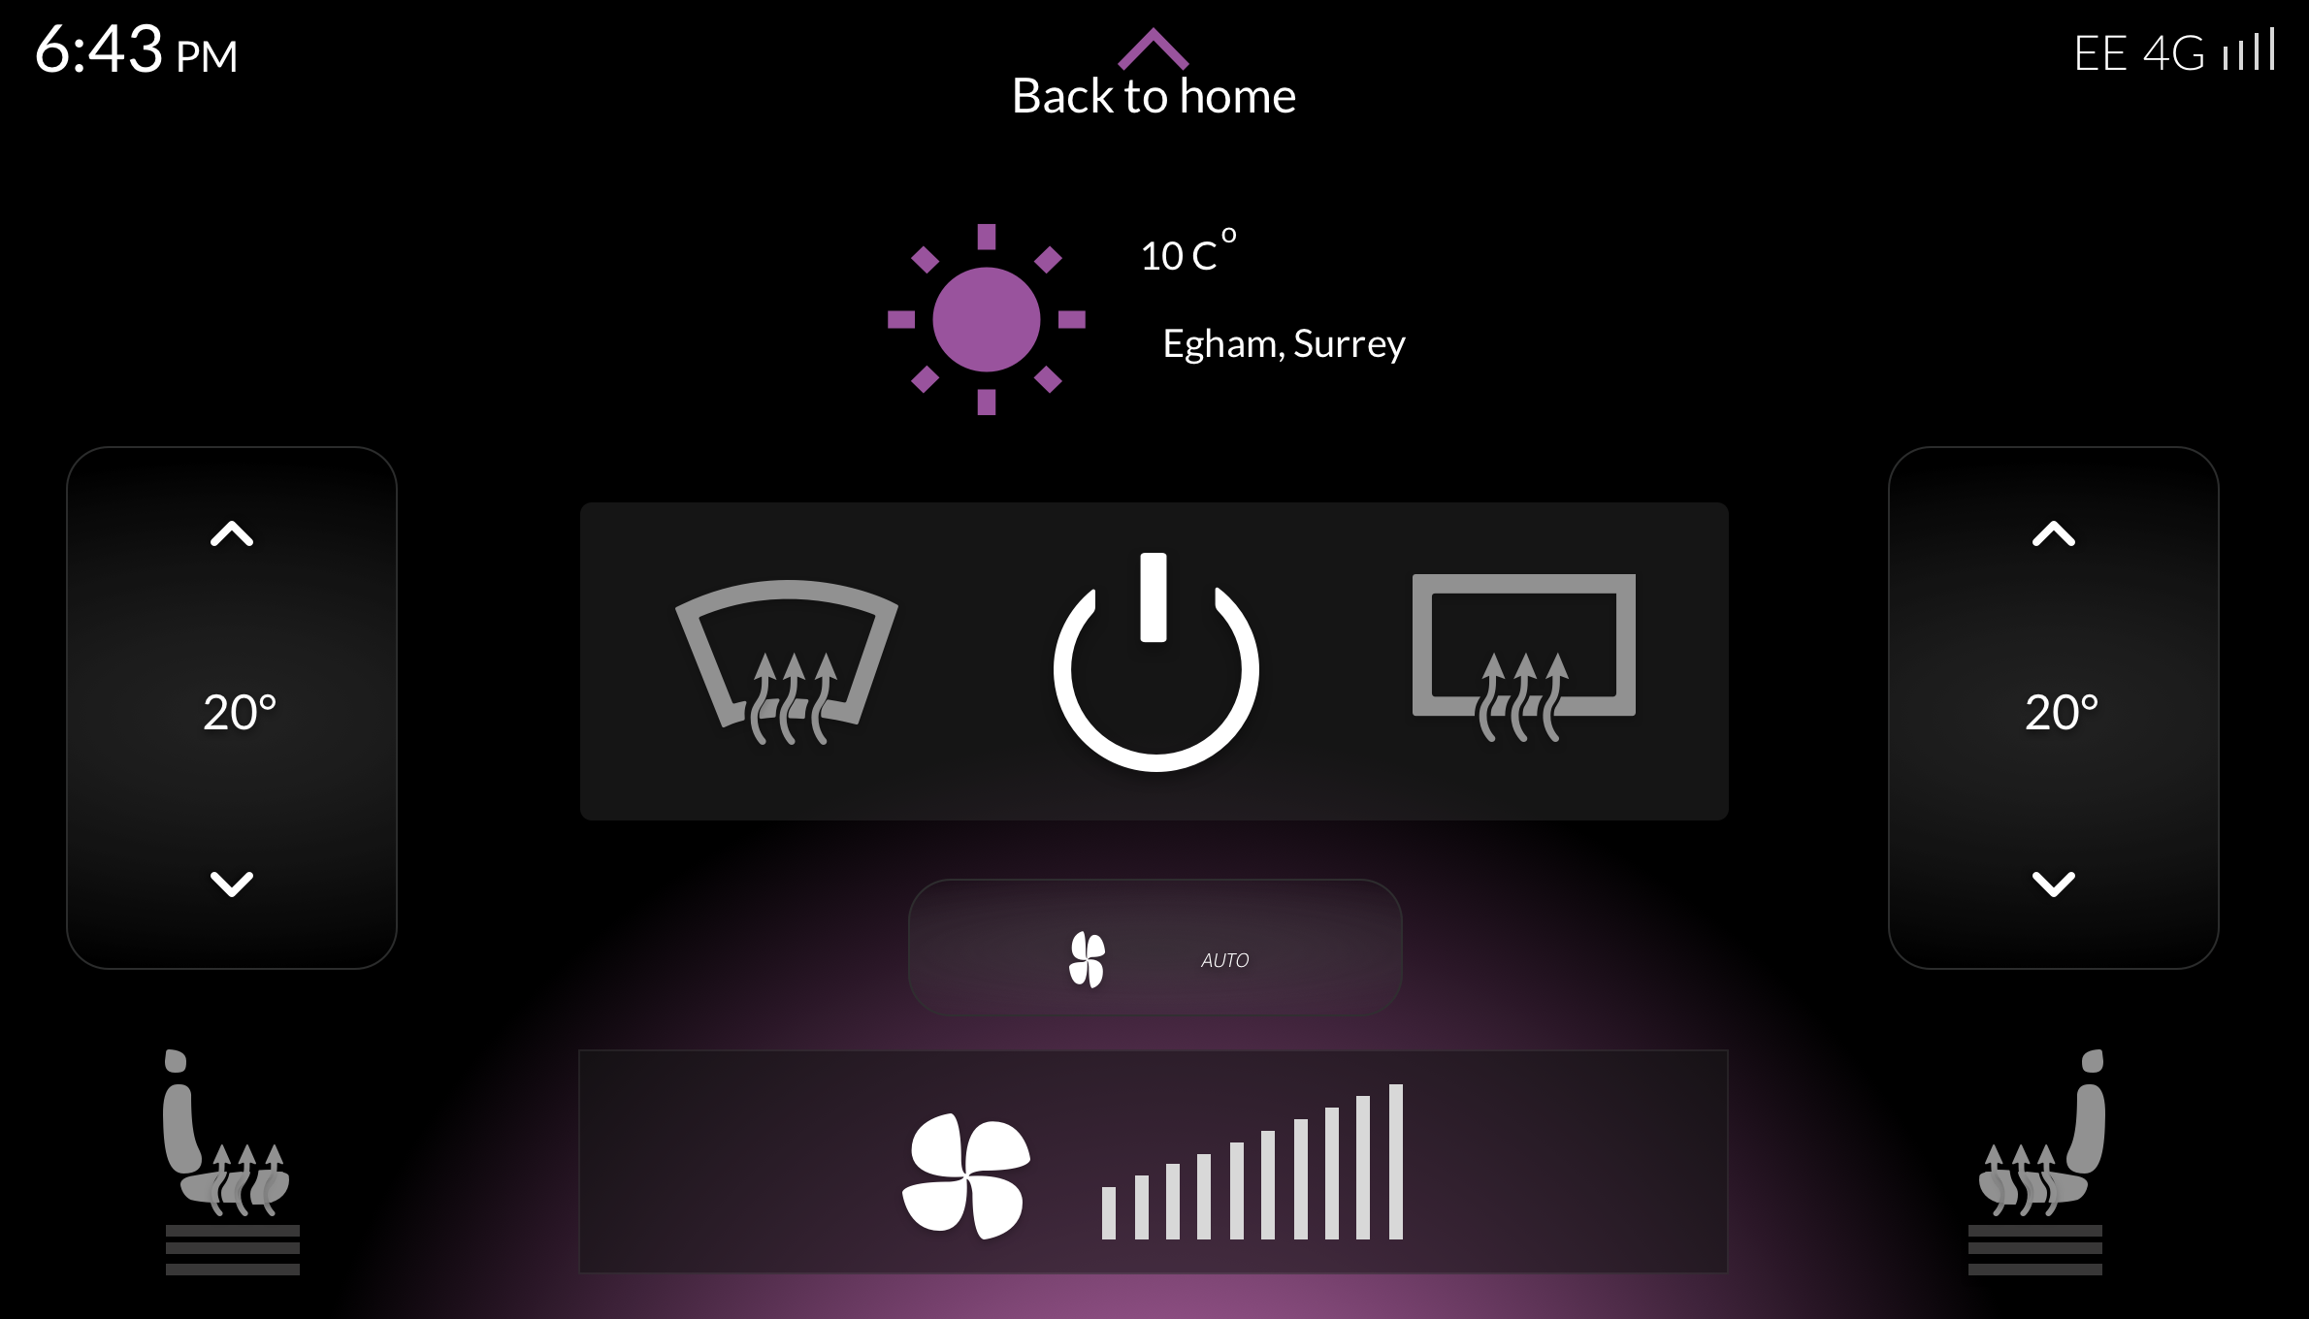
Climate Controls

Slide 14
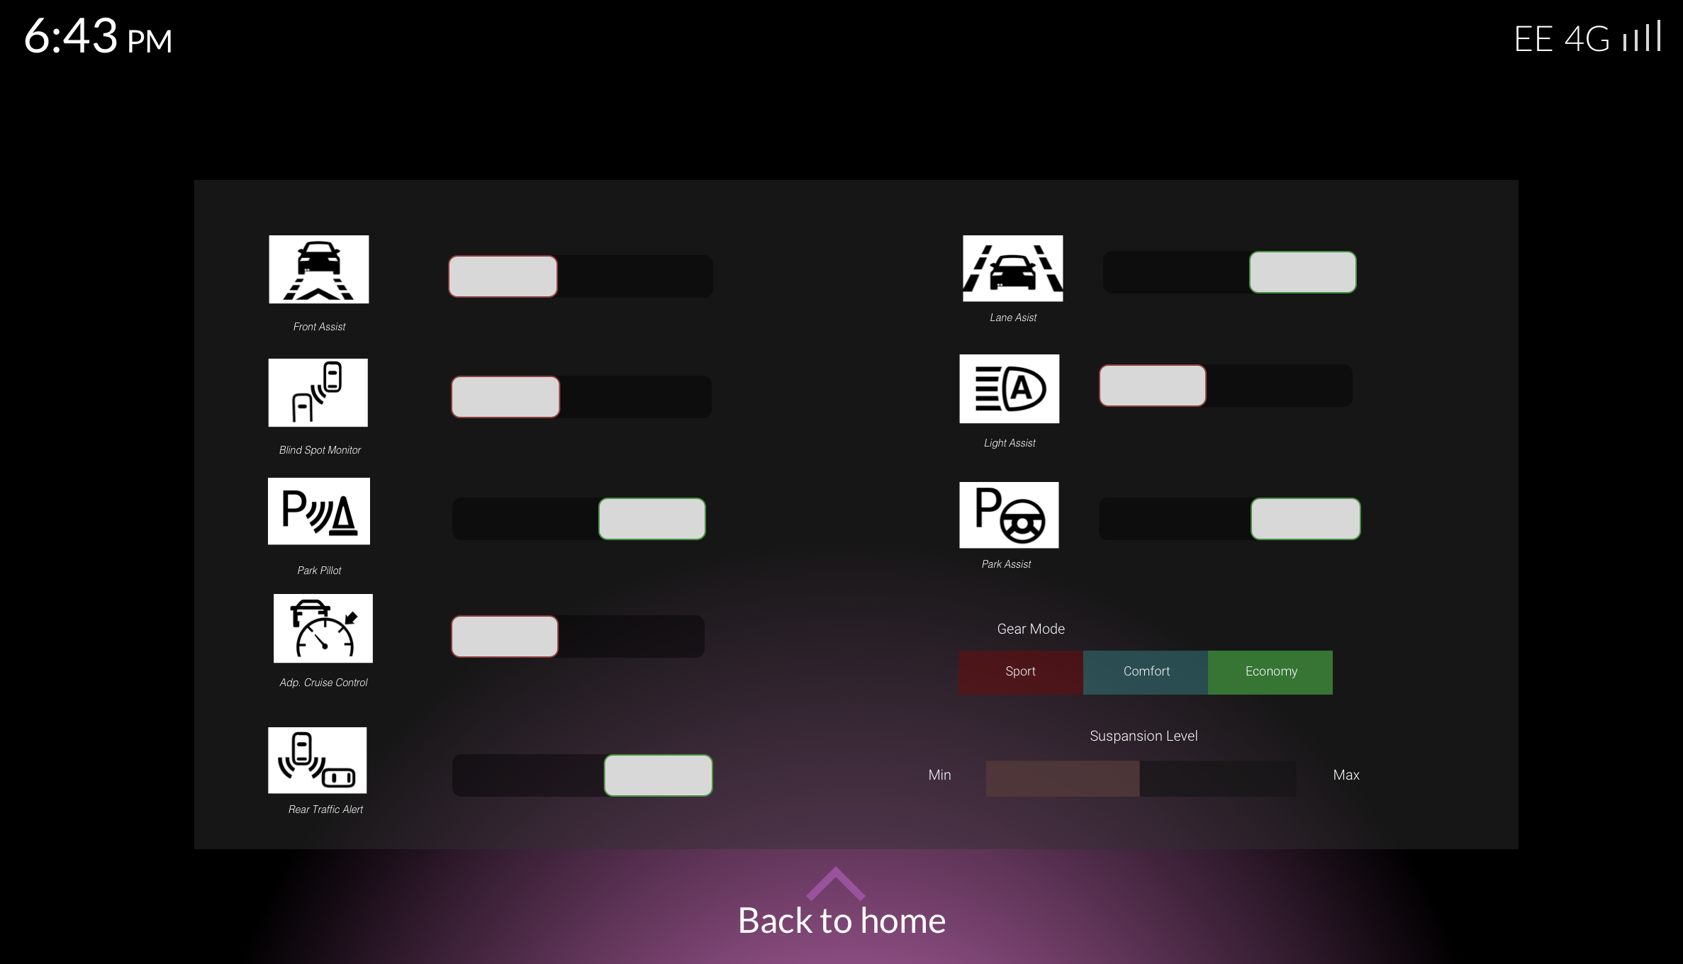
Dashboard Screen

Slide 15
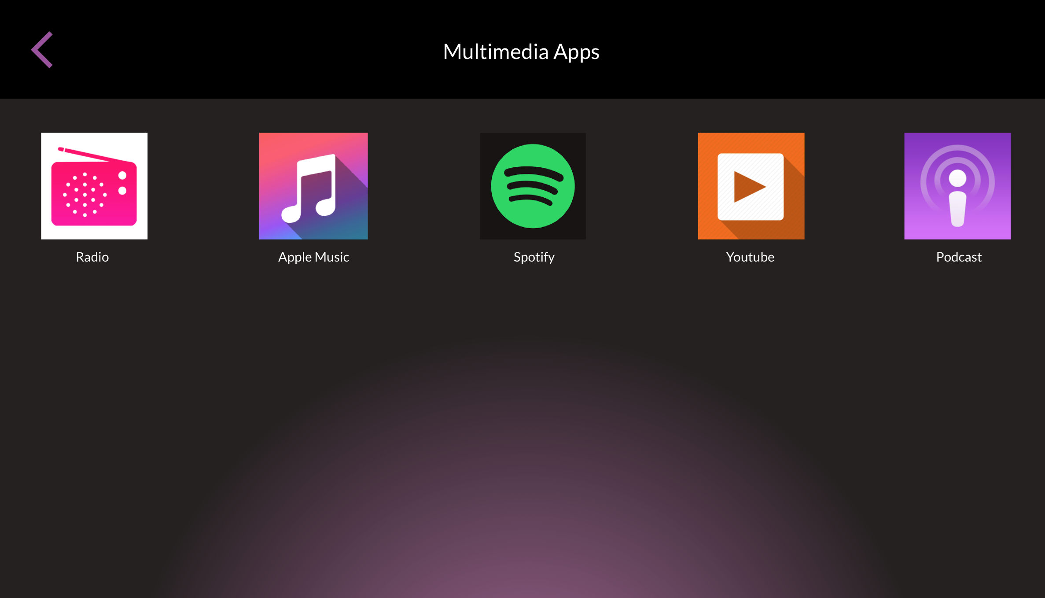
App Selection Screen

Slide 16
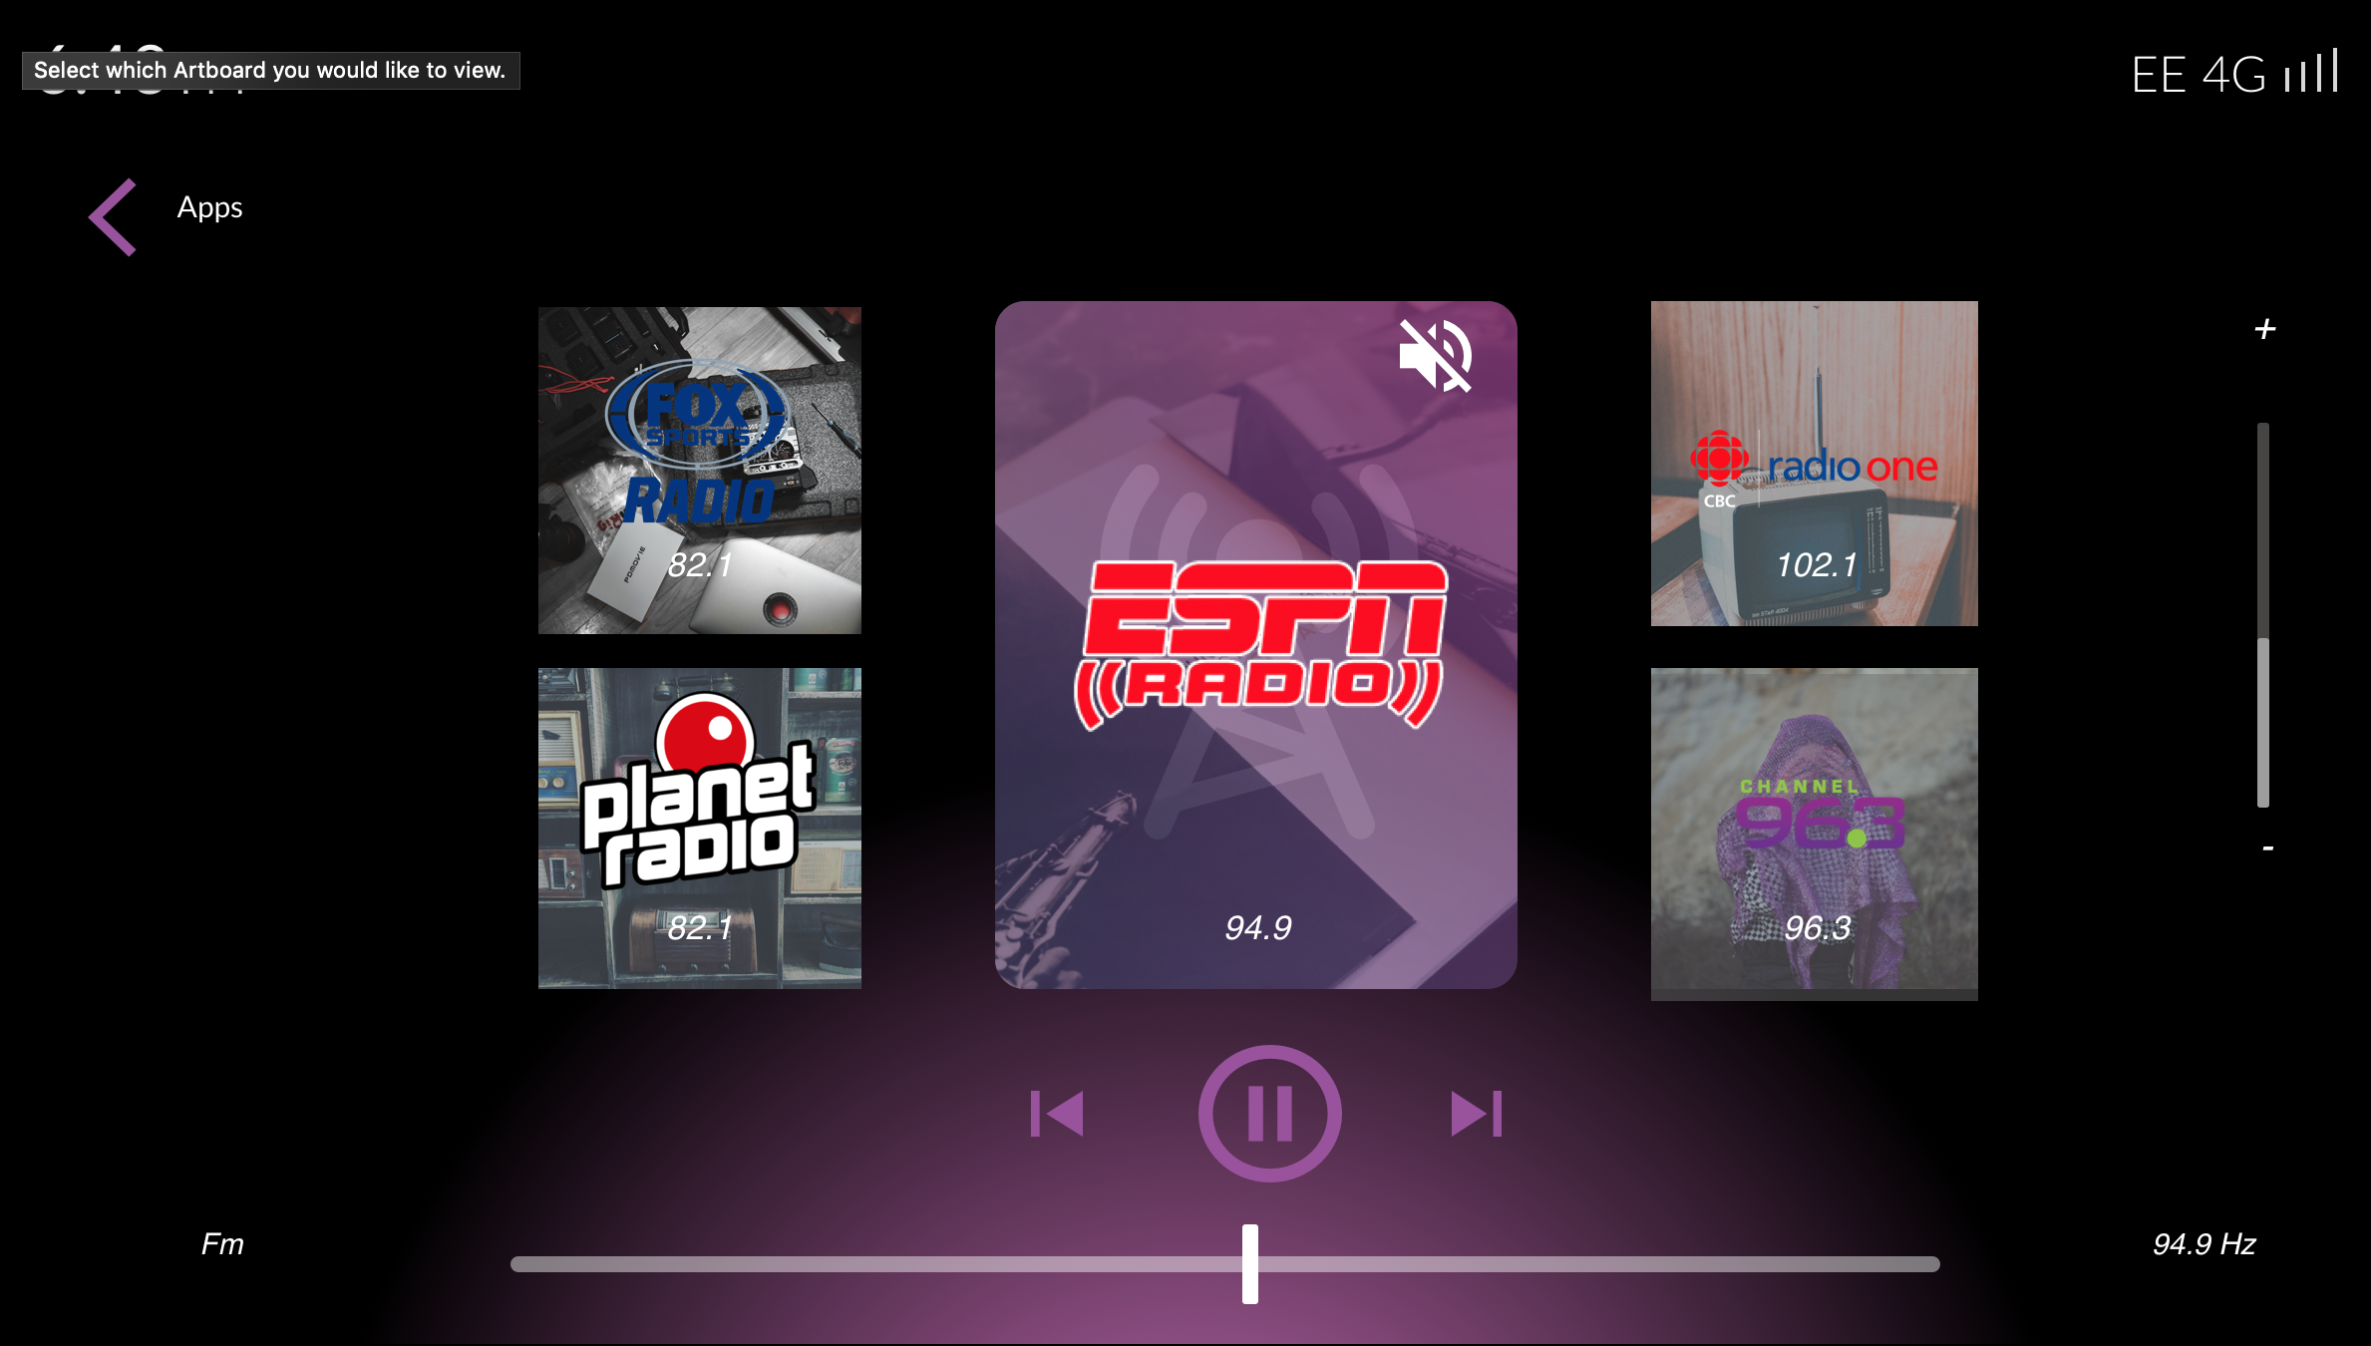
Radio App

Slide 17
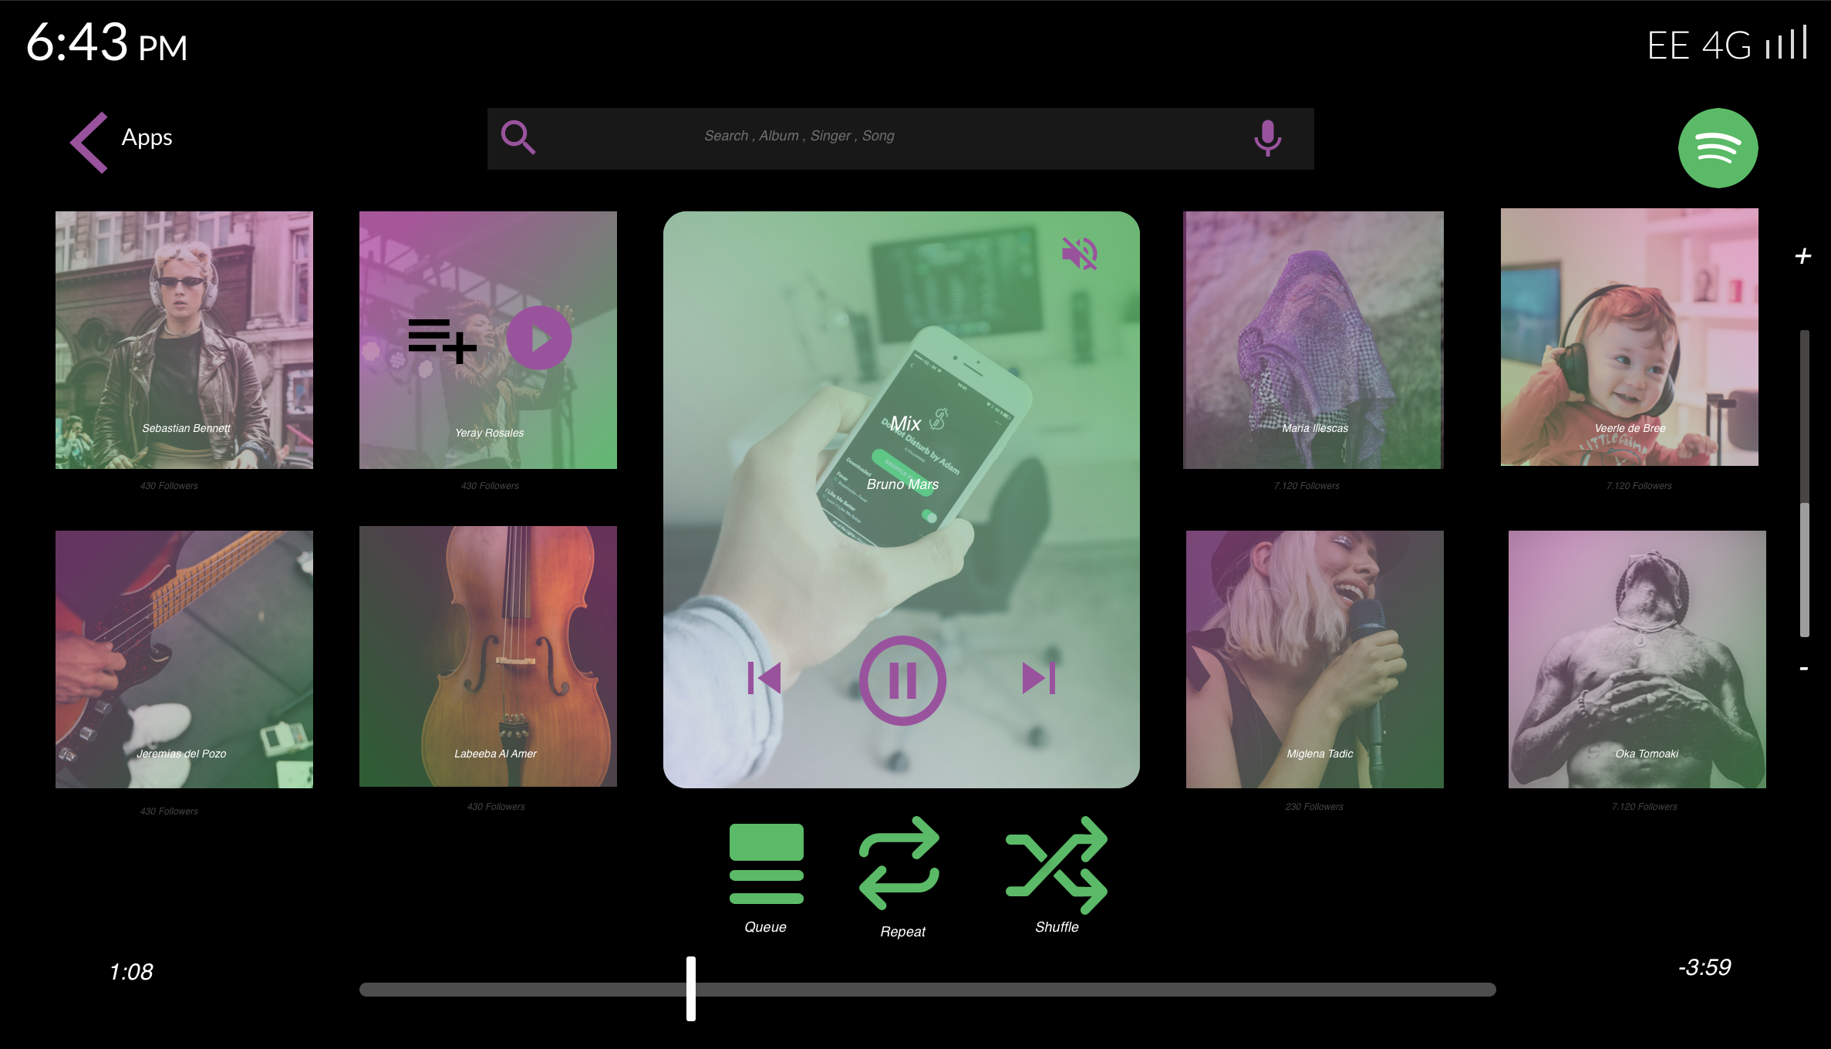
Spotify App

Slide 18
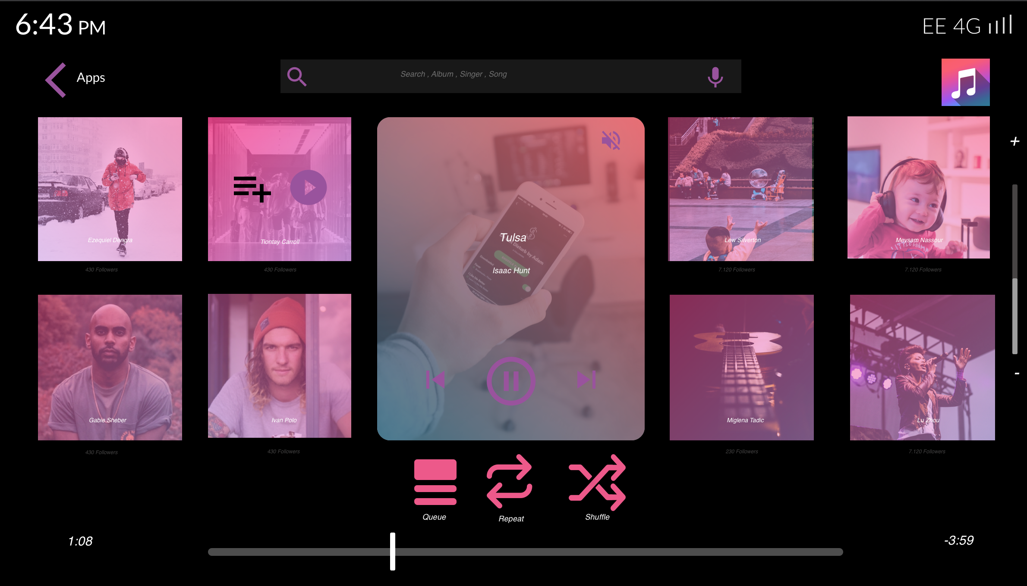
Apple Music App

Slide 19
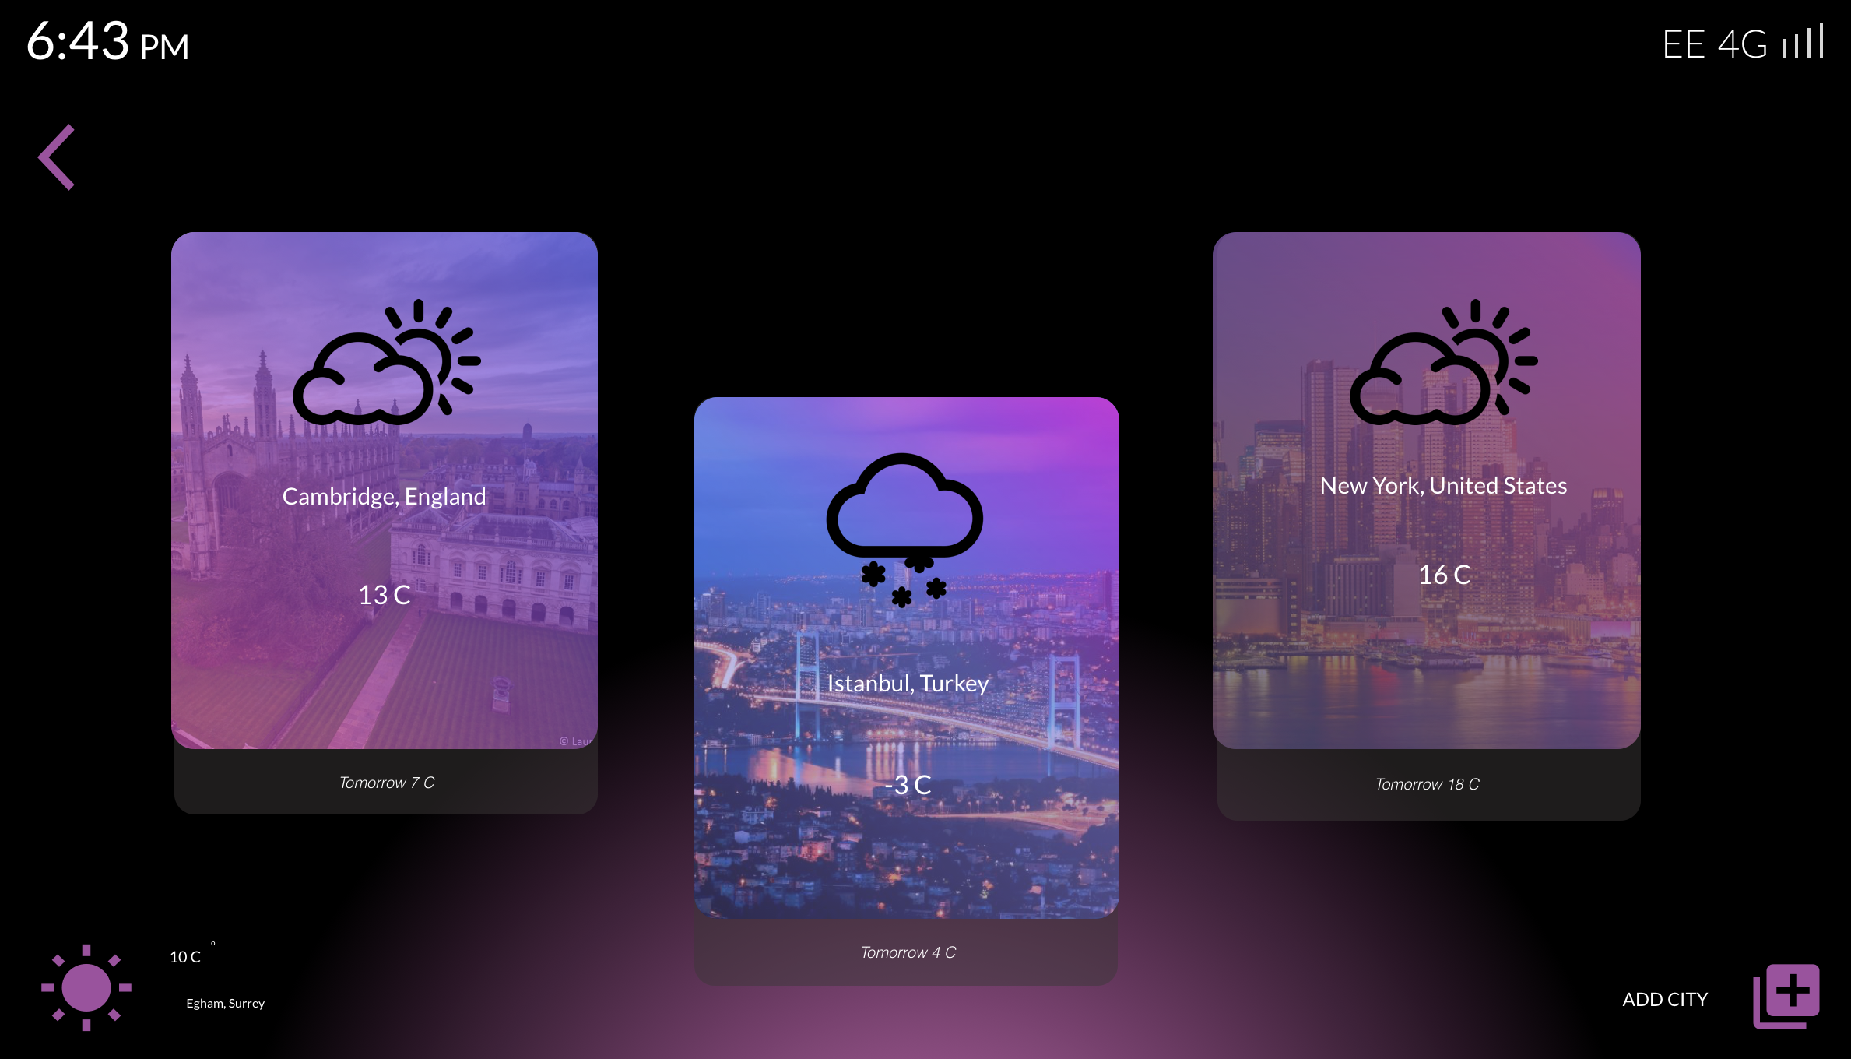
Weather App

